Slide 1
College Senior Capstone for Advocacy of Early Language Learning
Yoko H. Sakurauchi, Ed.D. (ysakura@pdx.edu)
COFLT Fall Conference
Friday, October 11, 2019

Slide 2
Portland State University Senior Capstone Course
UNST421: Japanese & Chinese Language Program for Youth
6 credits for Winter-Spring sequent terms
10-20 students enrolled
Japanese, Chinese, other foreign languages, Applied Linguistics, Education, Art, Music, and Performing Arts, and other majors applicable. Basic Japanese or Chinese (completion of JPN/CHN201) is recommended but not a requirement.
The class meets once a week for two hours.
Textbook: Curtain, H. & Dahlberg, C. A. “Language and learners: making the match – world language instruction in K-8 classrooms and beyond,” 5th ed. Pearson.

Slide 3
Main Assignments (Outside The Classroom)
Volunteering as a teaching assistant at an immersion classroom in a local elementary school
The International School (Low-K through 5th Grade)
20 hours minimum (bi-weekly logs)
The first visit and class observation
Instructor’s observation in the end of Spring Term
Conducting a promotion activity as an advocate of early language learning
Have a booth at a cultural event
Create a website or YouTube video
Make posters and post them at community bulletin boards
Final presentation and paper

Slide 5
Small Assignments
Two Essays
Self reflection of the Multiple Intelligences (MI) and Kolbs Learning Styles questionnaires
Class observation
Two Presentations
Chapter presentation and facilitation of discussion
Activity demonstration
Small presentations and reports
Language Policies in the world
Less Commonly Taught Languages (LCTLs)

Slide 6
Multiple Intelligences
Linguistic
Logical-Mathematical
Spatial
Bodily-Kinesthetic
Musical
Interpersonal
Intrapersonal
Naturalist
How people process
Information and
Internalize information
(to learn) is different.

Slide 7
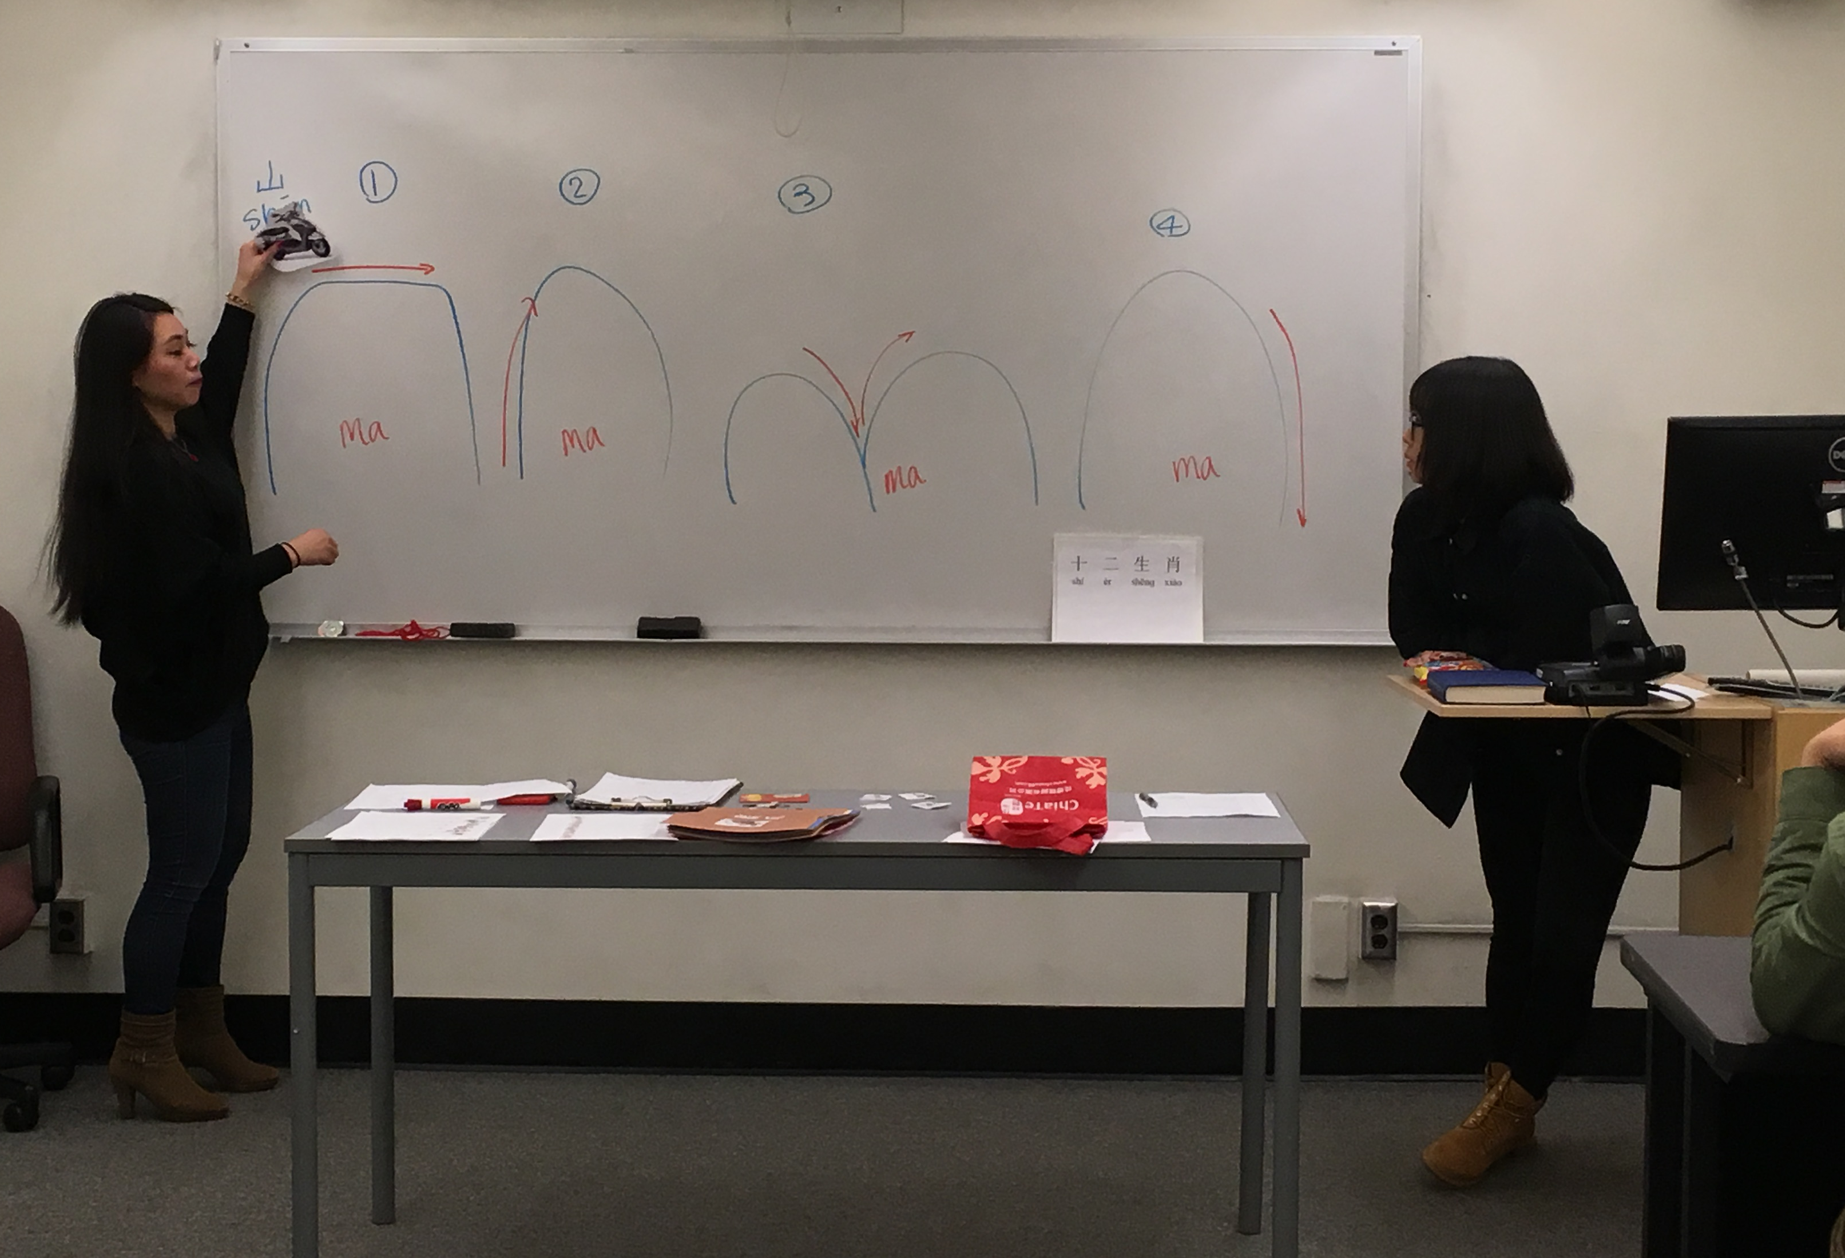

Slide 8
Promotion Activities
Purpose: To raise public awareness about
the importance of world language education or
Japanese/Chinese language & culture.

Slide 9
Promotion Activity Example
Example of Promotion Activity (website)
Posters

Slide 10
Promotion Example

Slide 11
Promotion Example

Slide 12
Promotion Example

Slide 13
Final Paper1: Thank-You Letters

Slide 14
Final Paper 2: Promotion Letters
Write promotion letters to:
Members of a school board
Superintendent or School administrators
Politicians
To promote world language education at an early age
Cite academic articles and research results as evidences

