Slide 1
David Bautista
Assistant Superintendent
Office of Learning
Equity Unit
Oregon Department of Education
Oregon Seal of Biliteracy

Slide 2
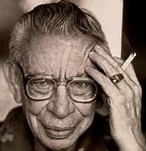
Sabine Ulibarrí
(1919-2003)
In the beginning was the Word. And the Word was made flesh. It was so in the beginning and it is so today. The language, the Word, carries within it the history, the culture, the traditions, the very life of a people, the flesh. Language is people. We cannot even conceive of a people without a language, or a language without a people. The two are one and the same. To know one is to know the other.

Slide 3

Our first Seals were awarded at graduation ceremonies in Woodburn, Salem-Keizer, Medford, Corvallis, Portland Public, Four Rivers Community School, and West Linn-Wilsonville this June 2015.

Slide 5
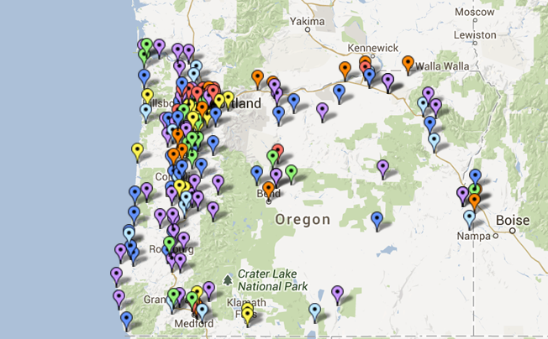
Map of Oregon’s Districts with English Learners

Slide 7
Oregon English Learner Statistics
Top ten districts with largest English Learner population by student count | Salem-Keizer | 8,204
 | Beaverton | 6,008
 | Portland | 4,606
 | Hillsboro | 3,126
 | Reynolds | 3,007
 | David Douglas | 2,512
 | Woodburn | 2,443
 | North Clackamas | 2,313
 | Tigard-Tualatin | 1,554
 | Gresham-Barlow | 1,309
Top ten districts with largest percentage of English Learners to total district enrollment | Woodburn | 44.6%
 | Nyssa | 35.9%
 | Jefferson County | 35.1%
 | Gervais | 33.8%
 | Umatilla | 33.8%
 | Reynolds | 26.3%
 | Milton-Freewater | 25.1%
 | David Douglas | 23.3%
 | Annex | 21.7%
 | Hood River | 21.4%

Slide 8
English Learners by Language
Language | Percentage of English Learners
Spanish | 76.6%
Russian | 3.5%
Vietnamese | 3.0%
English | 2.4%
Chinese | 1.7%
Somali | 1.2%
Arabic | 1.2%
Chuukese | 0.8%
Ukrainian | 0.8%
Korean | 0.8%

Slide 9
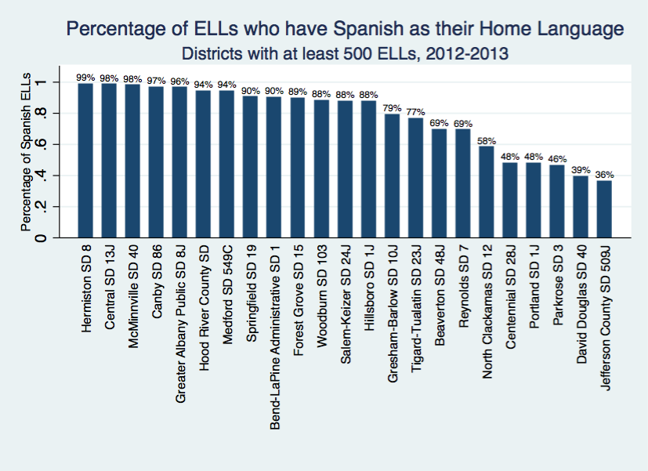

Slide 12
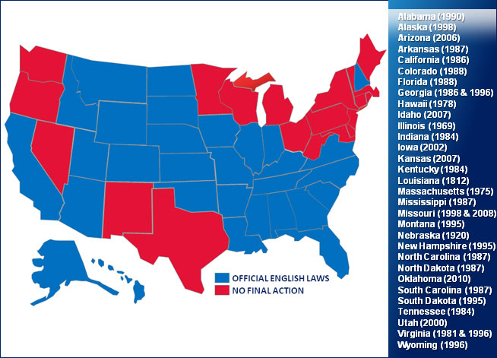
English Only States

Slide 13
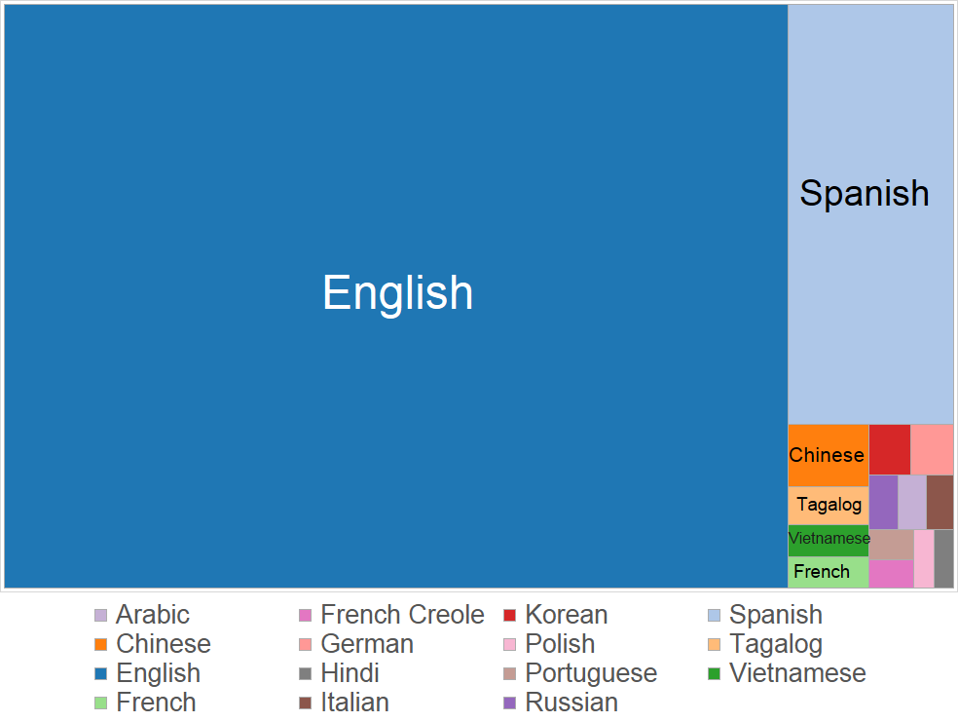

Slide 14
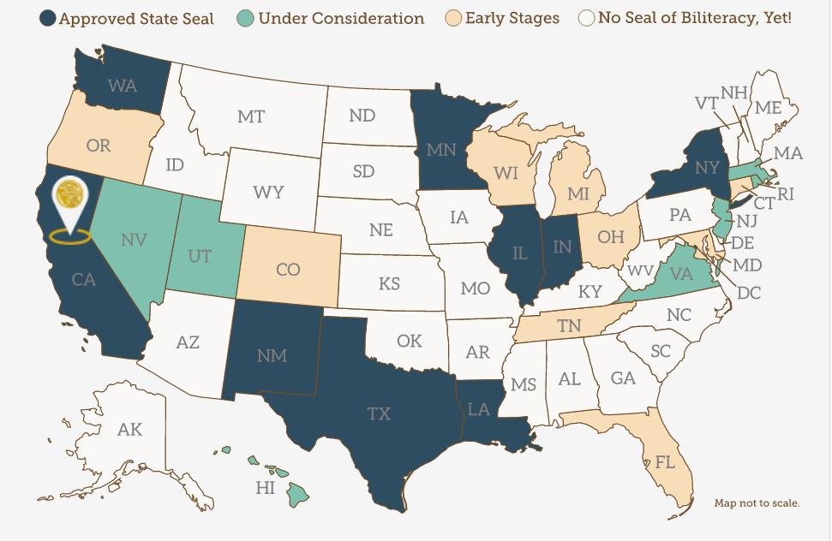
State Seals of Biliteracy
Source: http://sealofbiliteracy.org/
According to map (by Californians Together):
9 states have approved seals
15 states are in “Early Stages” (including Oregon) or in “Under Consideration” stage

Slide 15
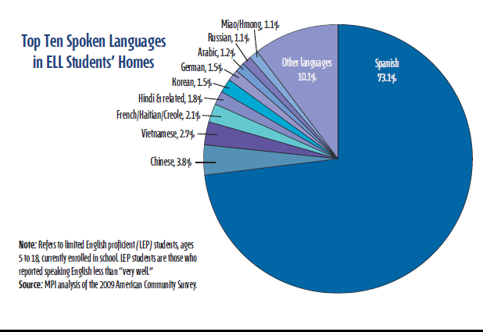

Slide 16
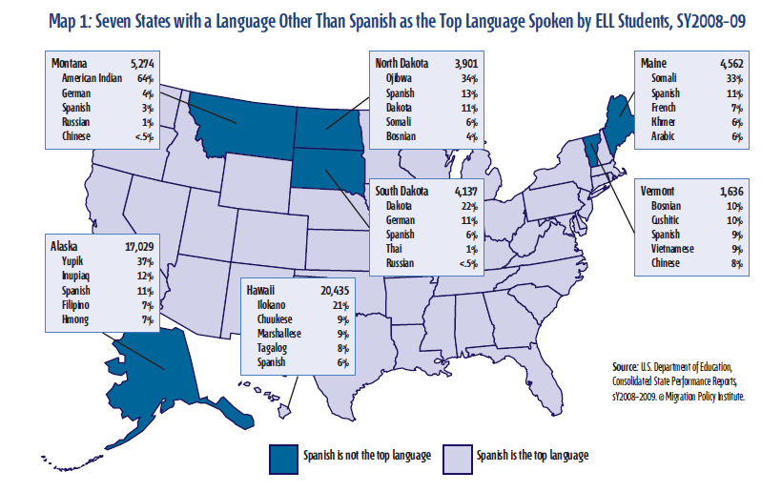

Slide 17
English Plus:
Responding to English Only
These include the states of New Mexico, Oregon, and Washington, and the cities of Atlanta, Cleveland, Dallas, San Antonio, Tucson, and Washington, D.C.

Slide 18
The English Plus Alternative
This "Statement of Purpose" is the founding document of the English Plus Information Clearinghouse (EPIC), a coalition of more than fifty civil rights and educational organizations opposed to Official English. EPIC was established in 1987 under the auspices of the National Immigration, Refugee, and Citizenship Forum and the Joint National Committee for Language

Slide 19
The founding endorsers of EPIC were:
The American Civil Liberties Union, American Jewish Committee, American Jewish Congress, Caribbean Education and Legal Defense Fund, Center for Applied Linguistics, Chinese for Affirmative Action, Coloradans for Language Freedom, Committee for a Multilingual New York, Conference on College Composition and Communication, Christian Church (Disciples of Christ), El Concilio de El Paso, Haitian American Anti-Defamation League, Haitian Refugee Center, Image de Denver, IRATE (Coalition of Massachusetts Trade Unions), Mexican American Legal Defense and Educational Fund, Michigan English Plus Coalition, META (Multicultural Education, Training, and Advocacy) Inc., National Association for Bilingual Education, National Coalition of Advocates for Students, National Council of La Raza, National Puerto Rican Coalition, New York Association for New Americans, Organization of Chinese Americans, Spanish-Speaking/Surnamed Political Association, Stop English Only Committee of Hostos Community College, Teachers of English to Speakers of Other Languages.

Slide 20
Oregon has a non-binding "English Plus" resolution (Senate Joint Resolution 16), officially endorsing multilingualism, passed by the legislature in 1989.
OREGON ENGLISH PLUS RESOLUTION
WHEREAS the diverse ethnic and linguistic communities have contributed to the social and economic prosperity of Oregon; and
WHEREAS it is the welcomed responsibility and opportunity of Oregon to respect and facilitate the efforts of all cultural, ethnic and linguistic segments of the population to become full participants in our community; and
WHEREAS Oregon's economic well-being depends heavily on foreign trade and international exchange and one out of five jobs is directly linked to foreign trade and international exchange; and
WHEREAS we wish to protect and promote the multilingual nature of communication that currently exists in Oregon and to build trust and understanding; and
WHEREAS English is already the predominant language of Oregon and legislation imposing English as the official language of Oregon impairs our pluralistic ideals; and
WHEREAS our federal courts have recognized that English-only rules can have an adverse impact on protected groups and constitutes discrimination; now, therefore,
Be It Resolved by the Legislative Assembly of the State of Oregon:
That the use of diverse languages in business, government and private affairs, and the presence of diverse cultures is welcomed, encouraged, and protected in Oregon.

Slide 21
Washington's House Bill 2129 (1989) established an official policy "to welcome and encourage the presence of diverse cultures and the use of diverse languages in business, government, and private affairs in this state." Oregon's Senate Joint Resolution 16 (1989) resolved "to welcome, encourage and protect diverse cultures and use of diverse languages in business, government and private affairs." Both were offered as alternatives to Official English bills.

Slide 22
English Plus Declaration
in New Mexico
State declarations of Official English produced a counter-trend: legislative endorsement of English Plus. In March 1989, at the urging of the New Mexico State Task Force on Modern and Classical Languages, the New Mexico legislature adopted House Joint Memorial 16, a nonbinding resolution "Supporting Language Rights in the United States." It thus became the first state to adopt an English Plus resolution, soon followed by Oregon and Washington State.
WHEREAS the people of New Mexico promote the spirit of diversity-with-harmony represented by the various cultures that make up the fabric of our state and American society; and
WHEREAS the people of New Mexico acknowledge that "English Plus" best serves the national interest since it promotes the concept that all members of our society have full access to opportunities to effectively learn English plus develop proficiency in a second or multiple languages; and
WHEREAS the people of New Mexico recognize that the position of English in the United States needs no official legislation to support it; and
WHEREAS the people of New Mexico recognize that for survival in the twenty-first century our country needs both the preservation of the cultures and languages among us and the fostering of proficiency in other languages on the part of its citizens;
NOW THEREFORE BE IT RESOLVED ... that the First Session of the Thirty-Ninth Legislature of the State of New Mexico hereby reaffirms its advocacy of the teaching of other languages in the United States and its belief that the position of English is not threatened. Proficiency on the part of our citizens in more than one language is to the economic and cultural benefit of our state and the nation, whether that proficiency derives from second language study by English speakers or from home language maintenance plus English acquisition by speakers of other languages. Proficiency in English plus other languages should be encouraged throughout the State.

Slide 23
“We bring up children to be bilinguals, not for the sake of language, but for the sake of children”
Adopted from Ioan Bowen Rees

